Slide 1
WebAssembly Development With Blazor
Cory Maass
July 31, 2020

Slide 2
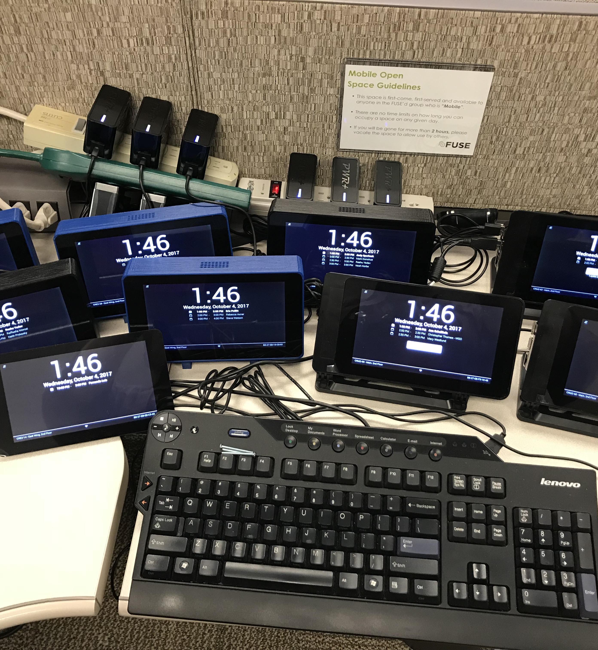
Cory Maass
At General Mills for 8 years
Solution Architect in Enterprise Data Capabilities
Solution Architect in EDDS (Jason Staloch)
Governance TFL
Original architect for go/demand
Creator of the Meeting Minders
Leading App Dev Cloud Discovery

Slide 3

Defined
WebAssembly (abbreviated Wasm) is a binary instruction format for a stack-based virtual machine. Wasm is designed as a portable compilation target for programming languages, enabling deployment on the web for client and server applications.
https://webassembly.org/

Slide 4

Yeah, but…..why?
JavaScript development landscape
Have you tried creating a new Angular or React application? How about creating one without using Webpack under the covers?
How many npm packages were required?
Performance
Browser Supported
With one notable exception

Slide 5

Supported Languages
Over 40!
Including:
C/C++
Python
Go
Rust
Java
PHP
.NET

Slide 6
Blazor
Single Page Application Development Framework
Browser + Razor = Blazor? (Must be new math)
Open Source, owned by the .NET Foundation
What it is Not
Browser plug-in
Silverlight or Flash

Slide 7
Blazor
Started as an experiment by Steve Sanderson
Two Flavors
Blazor Server – Original version
Blazor WASM - Officially release in May 2020
Prerequisites
Visual Studio 2019 16.6 or later
.NET Core 3.1.201 or later
Demo (https://skclusive.github.io/Skclusive.Blazor.Samples/Dashboard/)

Slide 8


“This is Code Camp;
not Slide Camp.”
-Wilson Gibbins

Slide 9
Resources
WebAssembly (https://webassembly.org/)
Blazor (https://dotnet.microsoft.com/apps/aspnet/web-apps/blazor)
Blazor University (https://blazor-university.com/)
Git Hub: https://github.com/CoryGM/GMICodeCamp2020
Pokedex (https://www.pokemon.com/us/pokedex/)
Component Libraries
Skclusive
Blazored
Blazorise
MatBlazor
Radzen
Syncfusion
Telerik
DevExpress

